Slide 1
MICRO CREDIT DEFAULTER PROJECT

Slide 2
Business Problem
A client in Indonesian Telecom Industry is collaborating with an MFI (Microfinance Institution) to provide micro-credit on mobile balances to be paid back in 5 days. The Consumer is believed to be defaulter if he deviates from the path of paying back the loaned amount within the time duration of 5 days.
In order to improve the selection of customers for the credit, the client wants some predictions that could help them in further investment and improvement in selection of customers.

Slide 3
MOTIVATION FOR THE PROJECT
Based on data provided from our client database, customer’s repayment of loan is assessed based on different factors. By building the model, we can assess which customers are highly likely to repay the loan, thereby it will be useful for those needy people who will repay the loan and also prevent the loss to the customer by avoiding loans to the defaulters.

Slide 4
ANALYTICAL PROBLEM FRAMING
For the given project, based on various parameters we need to predict whether the customer is a defaulter or not.
This is a classification problem. There are wide varieties of classification models like decision trees, random forests, nearest neighbor, Logistic Regression.
The data has been provided by client in a comma separated values(.csv) format.
This data set has around 2 lakh rows and 36 columns.

Slide 5
EXPLORATORY DATA ANALYSIS
Data preprocessing is a technique of converting raw data into useful format.
Data cleaning is a part of pre-processing technique where missing values will be dealt.
Msisdn column will be dropped as it contains phone number of customer and it wont impact the predictions.
Pcircle column will be dropped as it has same entry in all the columns.
Pdate column will be divided into 3 separate columns named year month and date.
The year column has only 1 value(i.e 2016)in all rows so deleting the year column.

Slide 6
We can note that there are few columns with negative values.
1)aon
2)daily_decr30=>Daily amount spent from main account, averaged over last 30 days (in Indonesian Rupiah)
3)daily_decr90=>Daily amount spent from main account, averaged over last 90 days (in Indonesian Rupiah)
4)rental30=>Average main account balance over last 30 days
5)rental90=>Average main account balance over last 90 days
6)last_rech_date_ma=>Number of days till last recharge of main account
7)last_rech_date_da=>Number of days till last recharge of data account

Slide 7
Converting the aon column to positive.
last_rech_date_ma, last_rech_date_da : these two columns indicate no.of days till last recharge of main and data accounts. This count of days also can’t be negative. These columns will be converted to positive.
Rental_30 and rental_90 columns indicate average main account balance over 30 and 90 days respectively.
When these columns are observed, We can note that even though the average rental balance is in negatives which means the customer owe rent to company,
they did repay their loans, which is most unlikely.
There might be other possibility that user will not be granted loan if they have negative balance. The negative entries in the two columns might be due to erroneous entry. So converted them to positive.
It has been mentioned that maxamnt_loans30 columns values has to be either 6 or 12.we can notice that there are huge no. of entries other than 6,12. Ignoring 0 because there might be users who hasn’t taken loans. Converting the other numbers to zero because there is no probability of loan repay amount other than 6 ad 12.There are 1047 rows that has values other than 6,12 and 0. There are 1047 records of values that are other than 6,12 and 0.Converted these 1047 records to zero because we can’t predict their repayment amount.

Slide 8
amt_loans90 column describes the total amount of loans taken by the user in span of 90 days. The presence of zero in this column indicates that the user hasn’t taken any loans.
There are 2043 rows in the data frame with zero in amt_loans90 column. Dropped the rows which has zero in the amt_loans 90 column because such rows wont be useful in predicting the loan repayment.

Slide 9
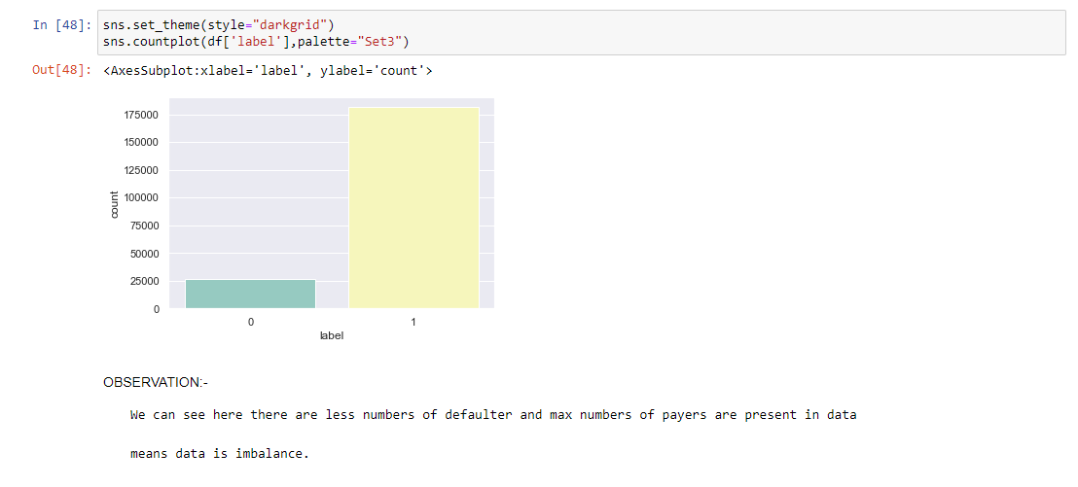
Visualizations

Slide 10
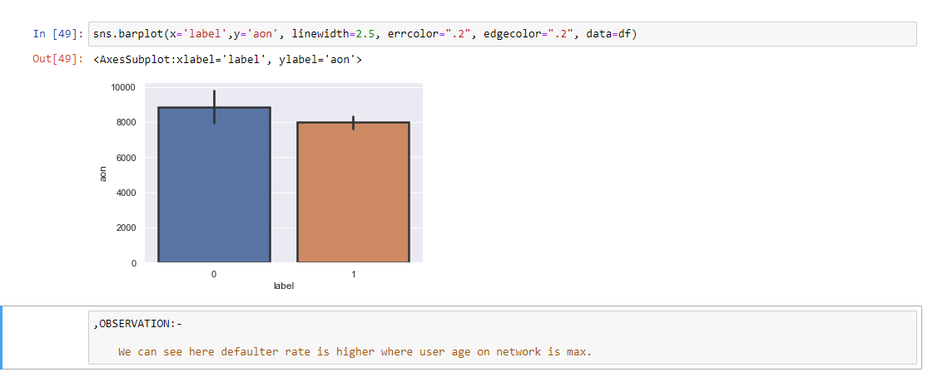

Slide 11
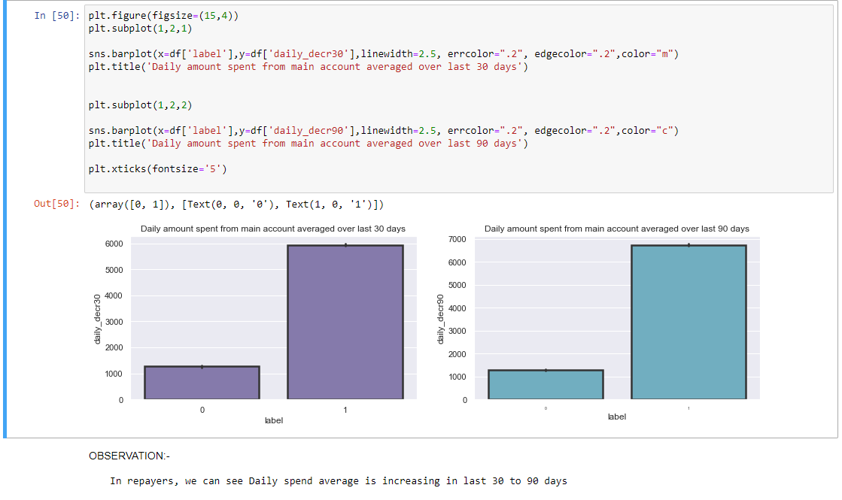
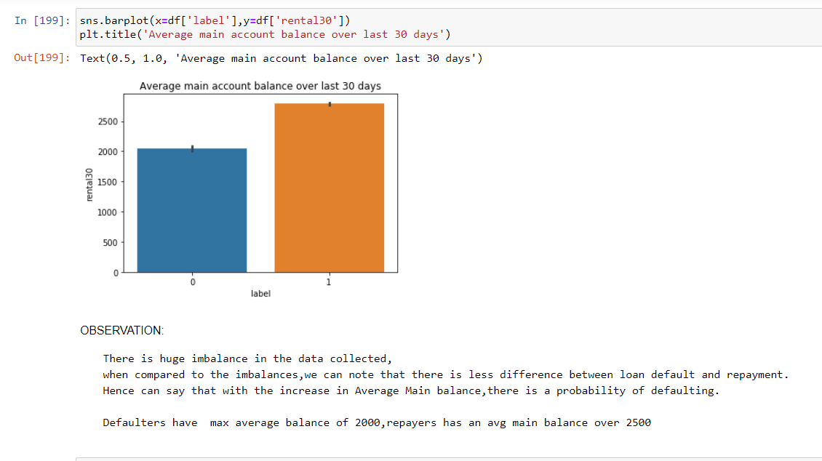

Slide 12
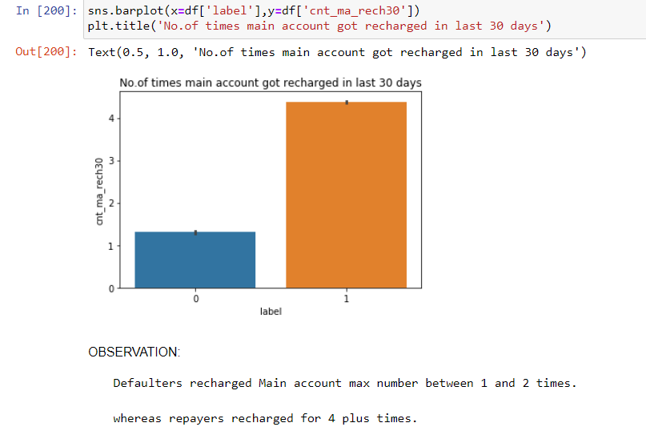
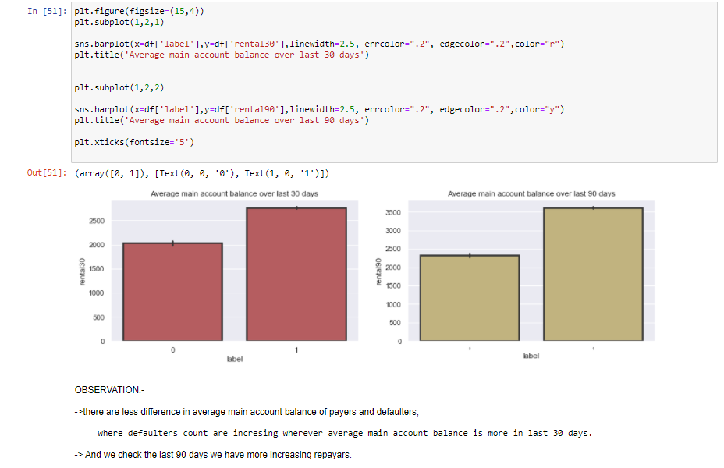

Slide 13
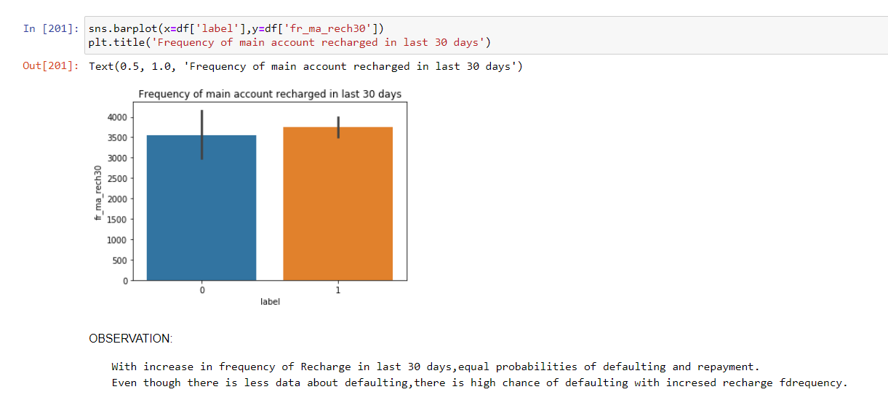
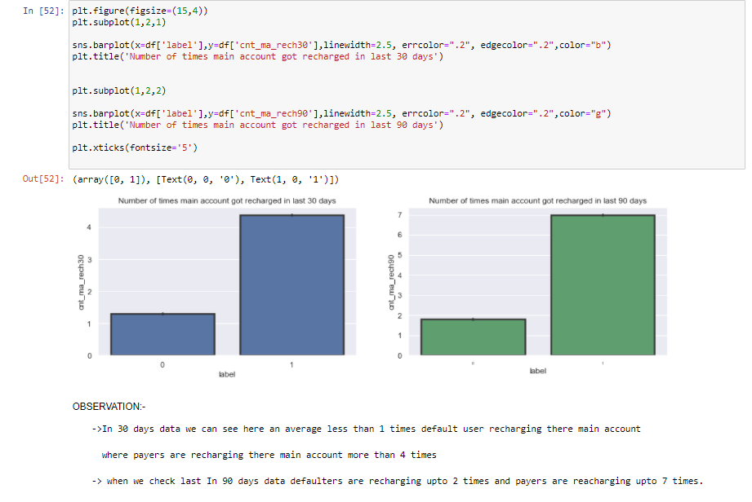

Slide 14
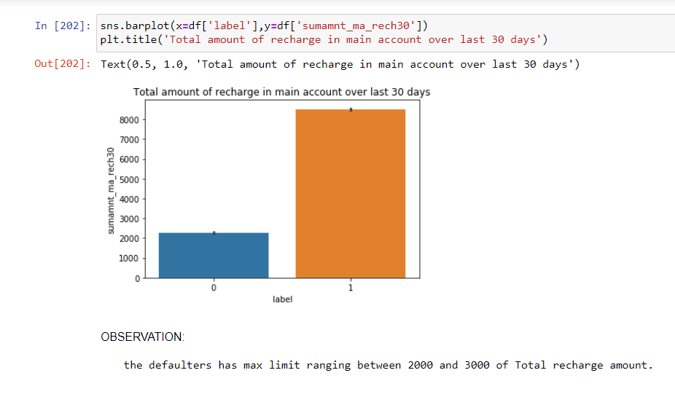
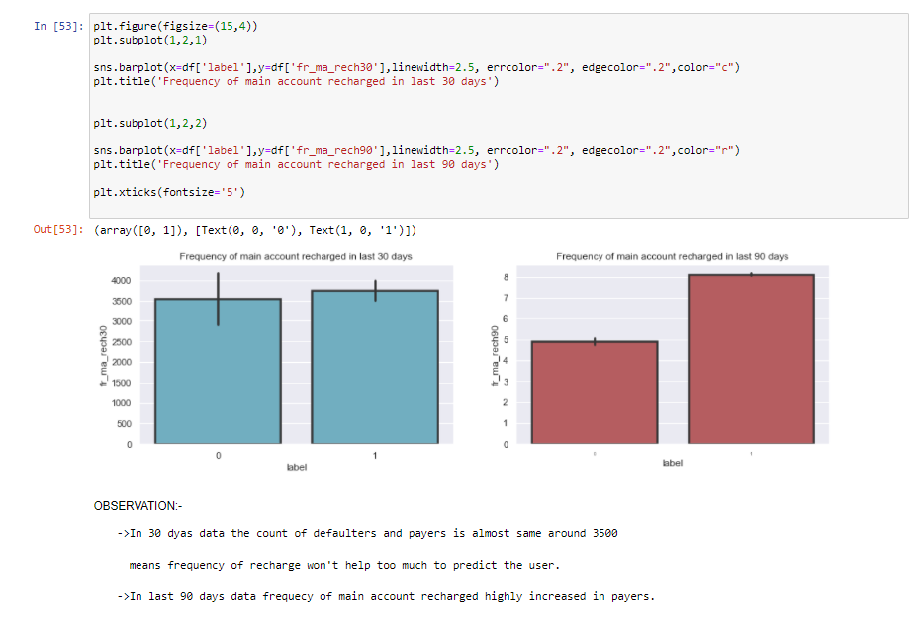

Slide 15
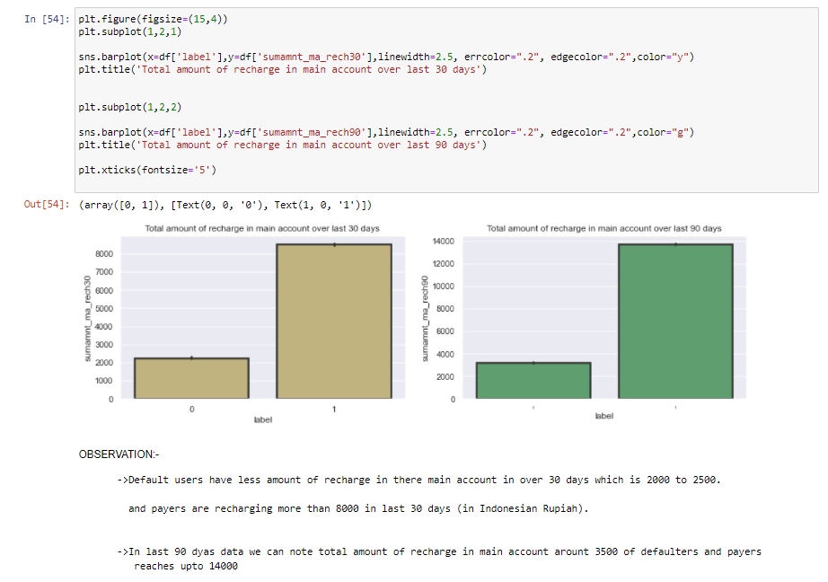
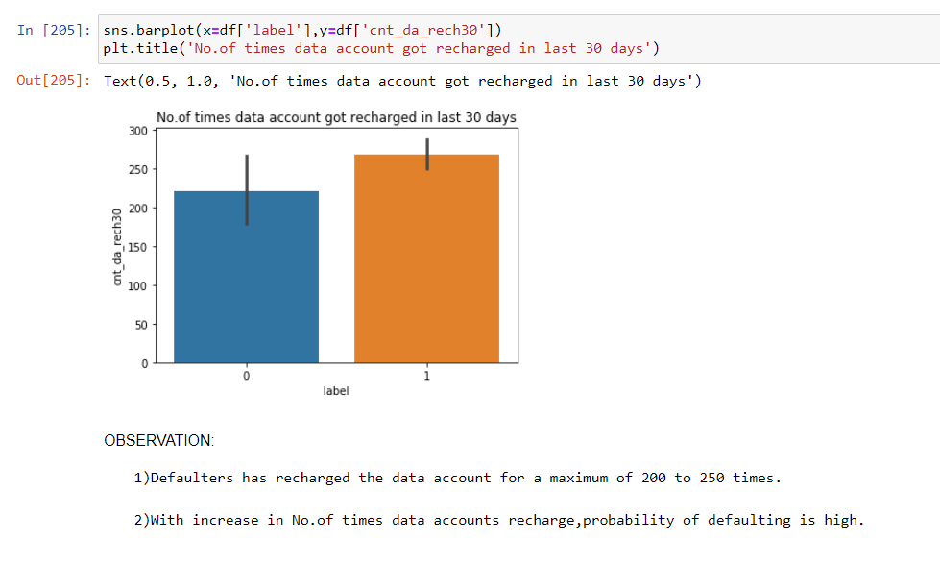

Slide 16
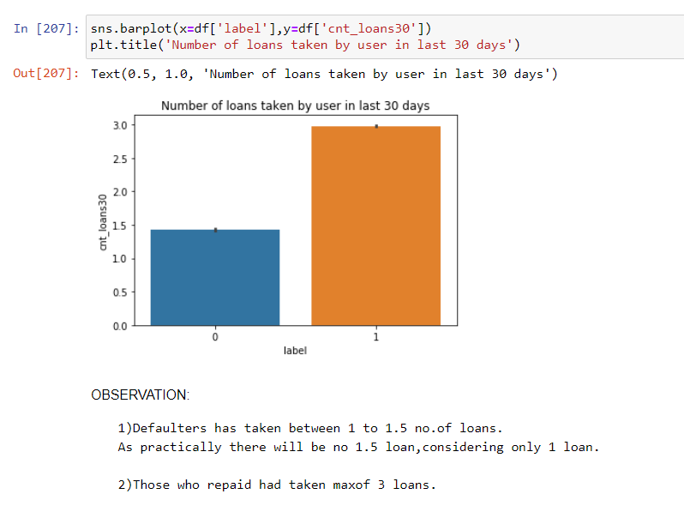
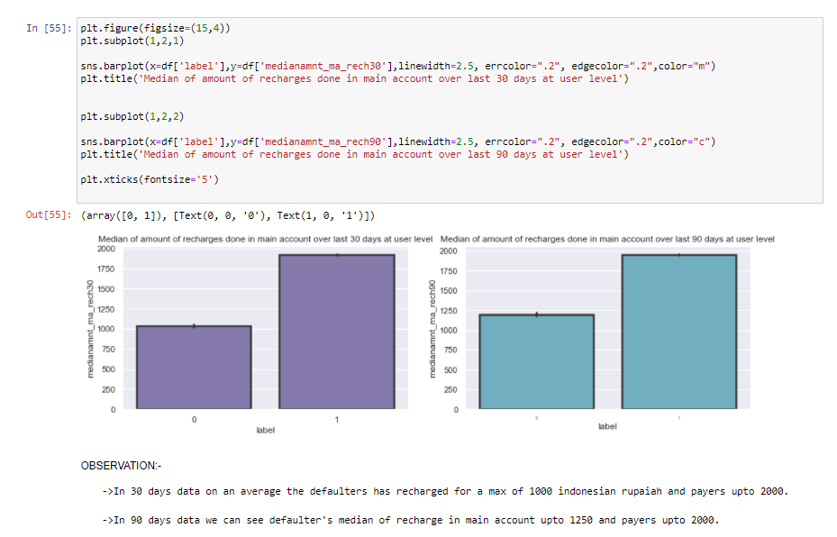

Slide 17
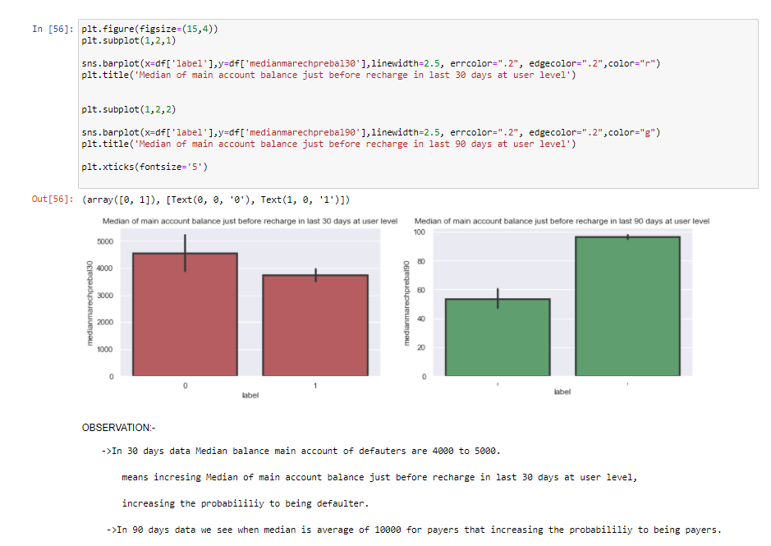
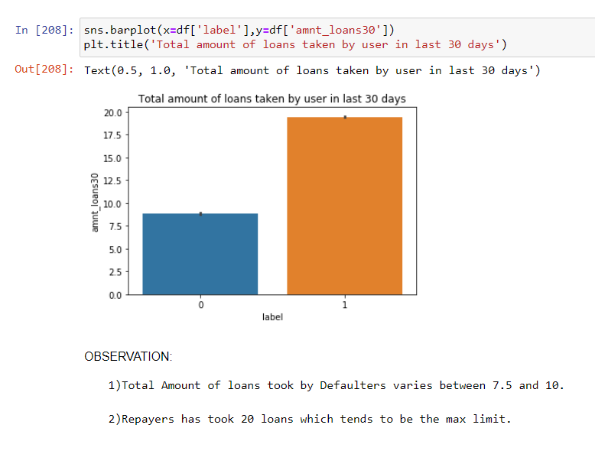

Slide 18
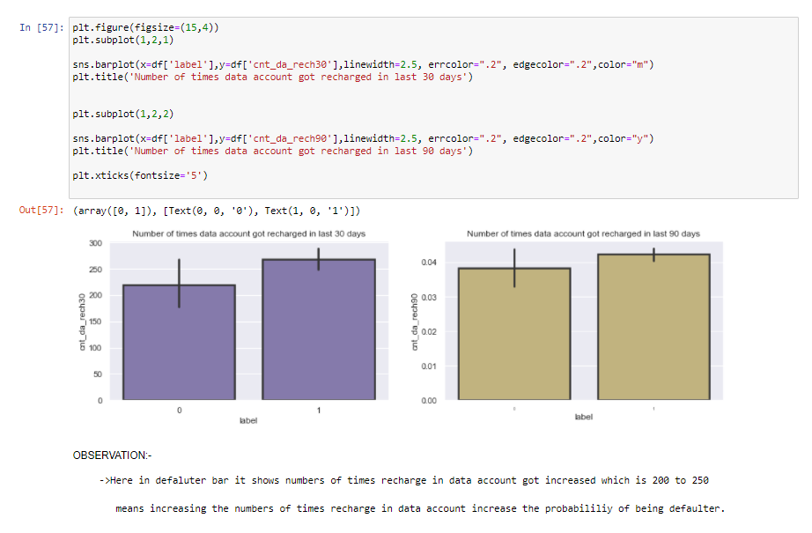

Slide 19
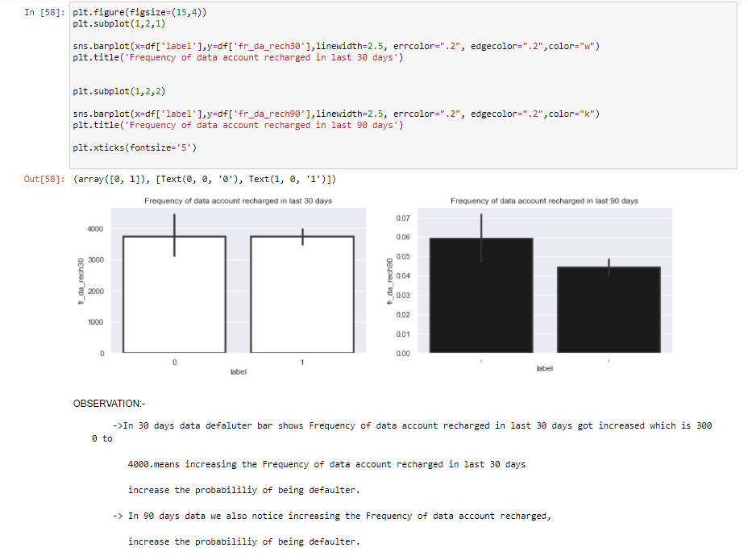
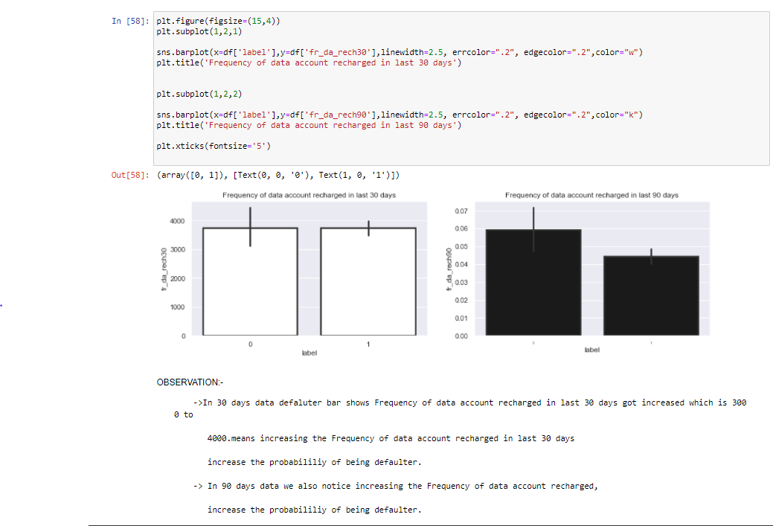
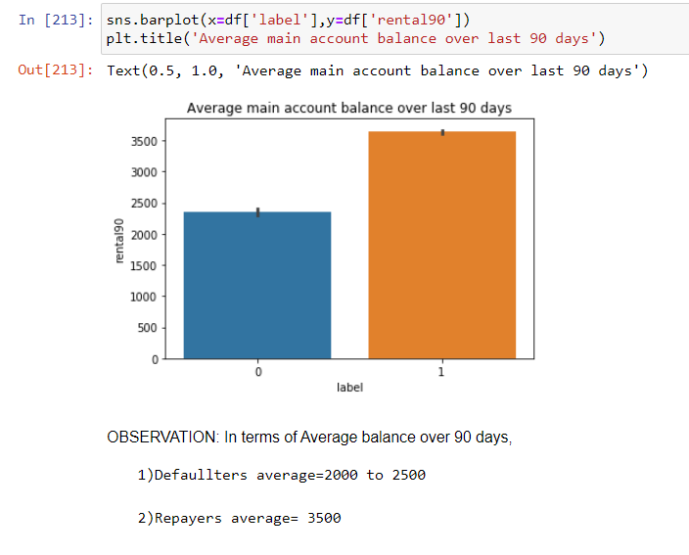

Slide 20
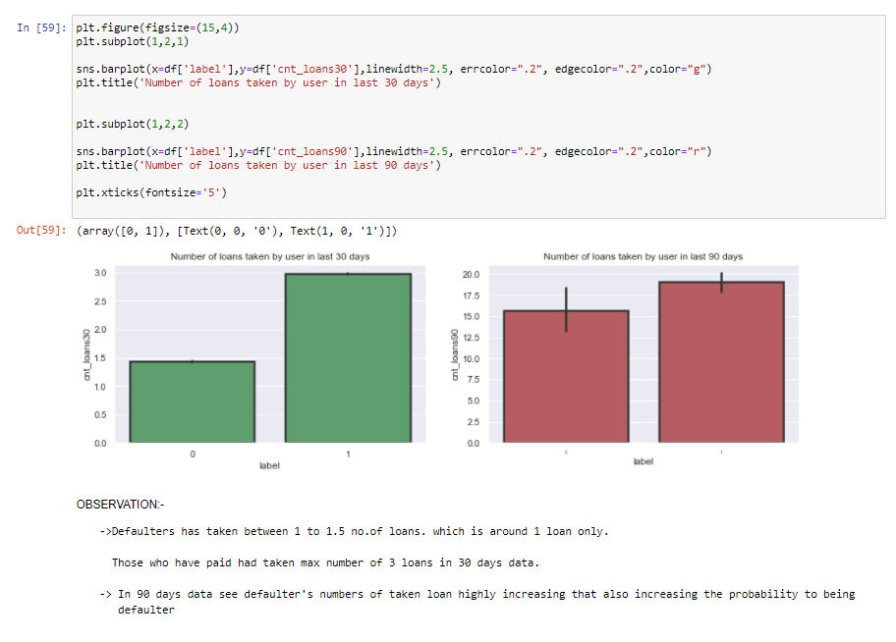
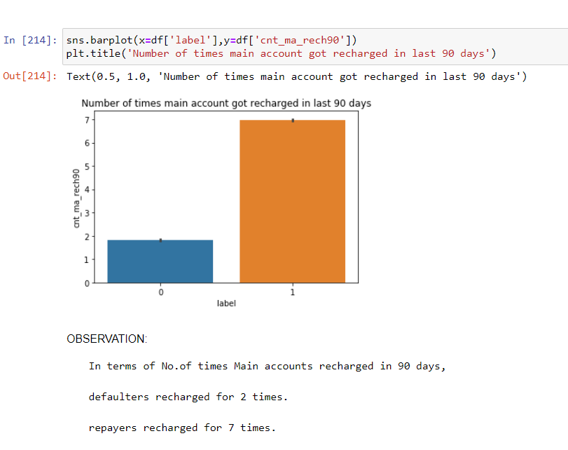

Slide 21
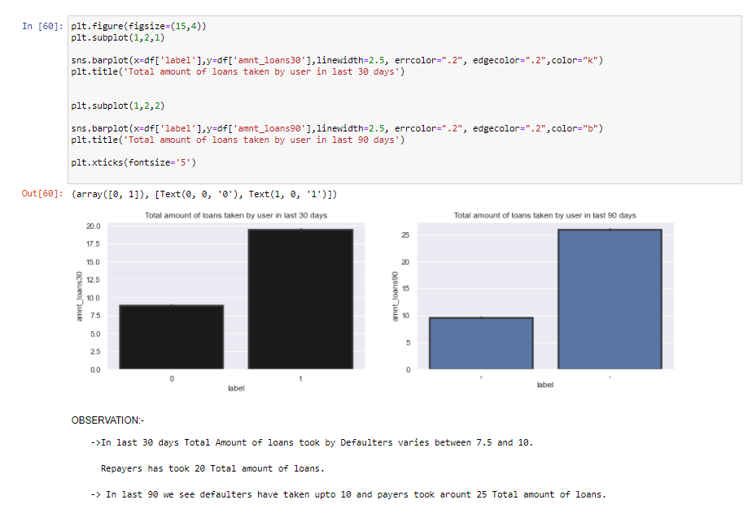
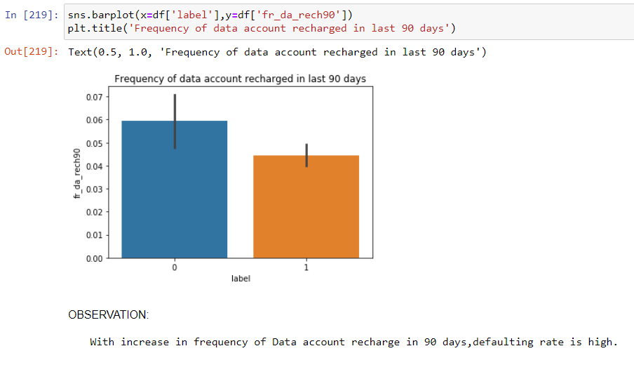

Slide 22
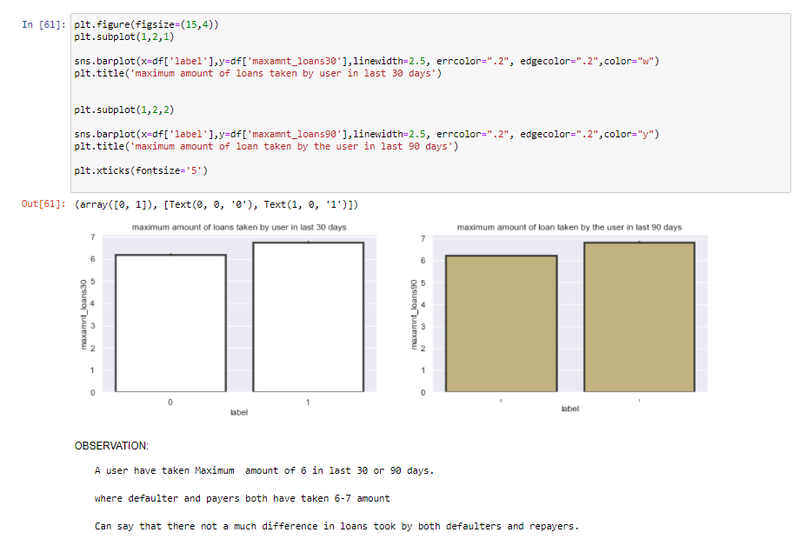

Slide 23
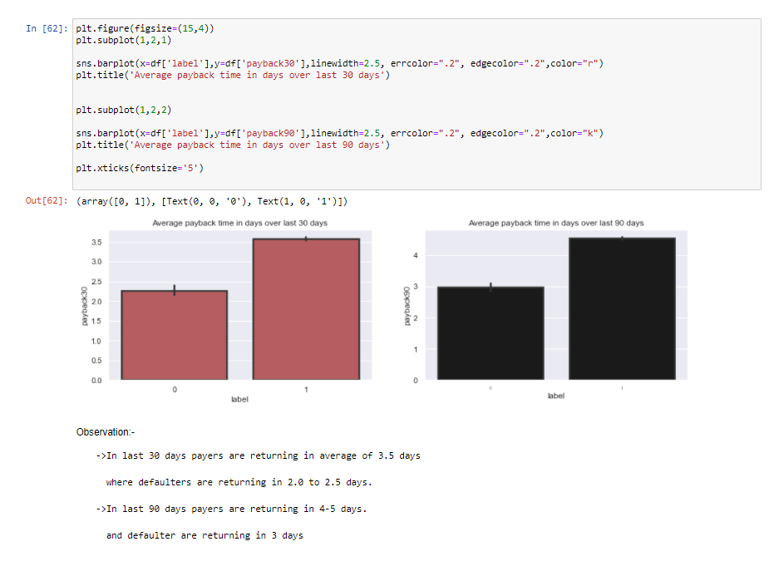

Slide 24
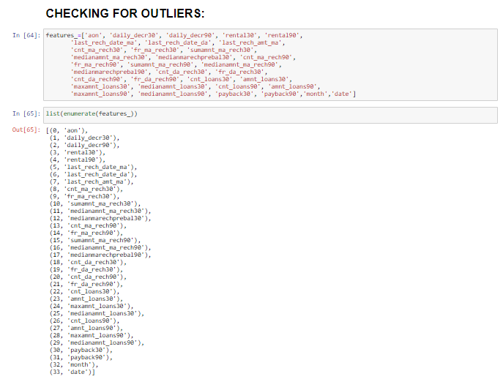

Slide 25
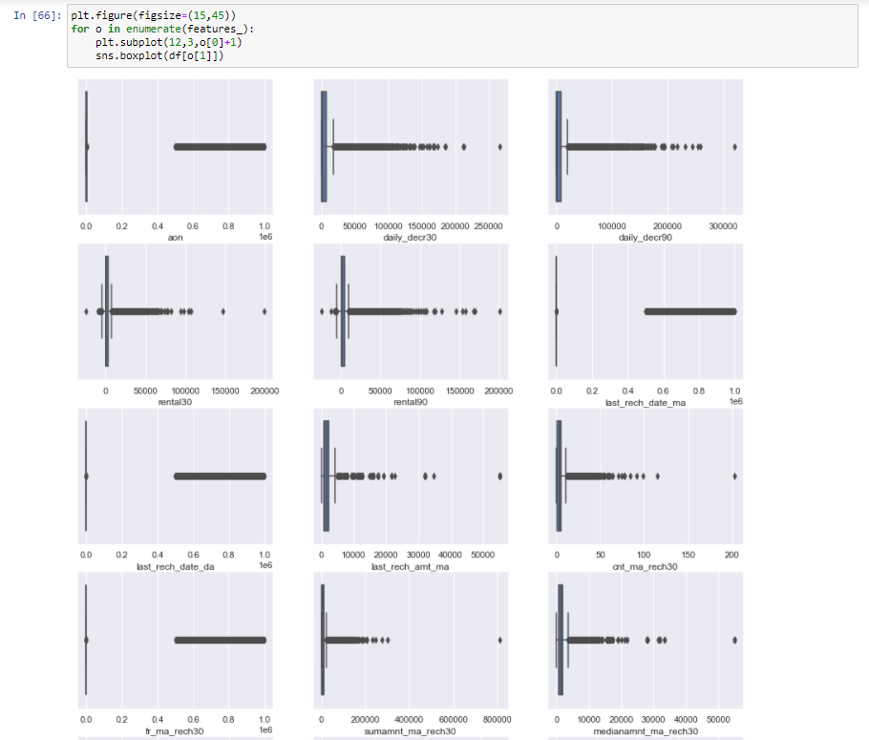

Slide 26
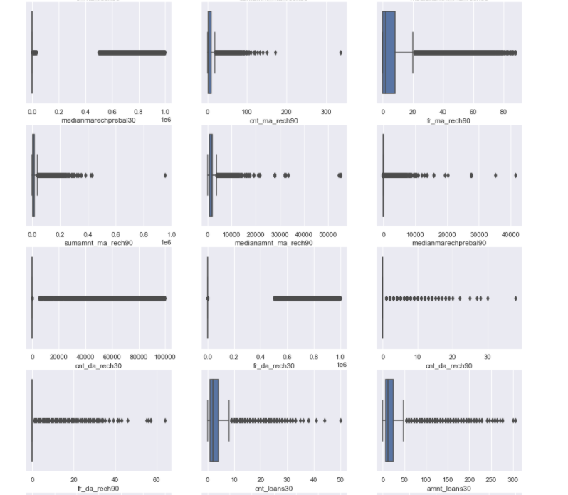

Slide 27
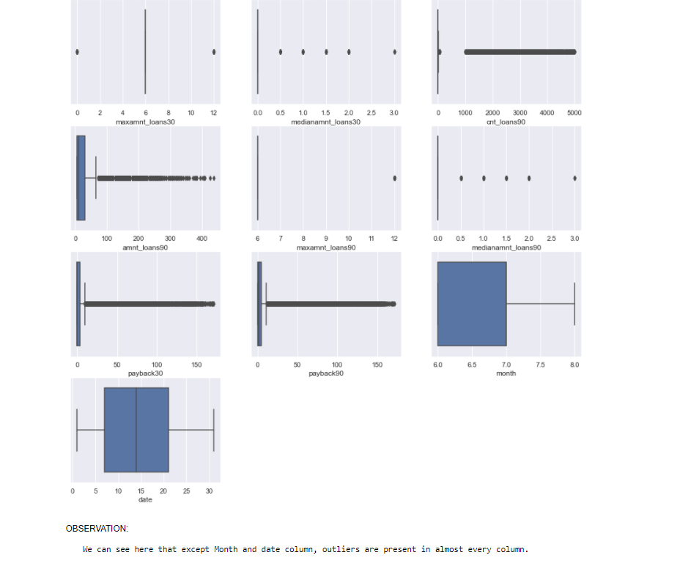

Slide 28
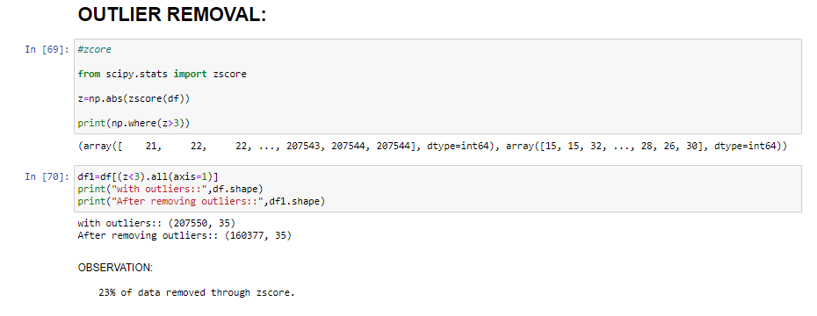
We can note that almost every column has outliers.
Different approaches for outlier removal:
1->Z score

Slide 29
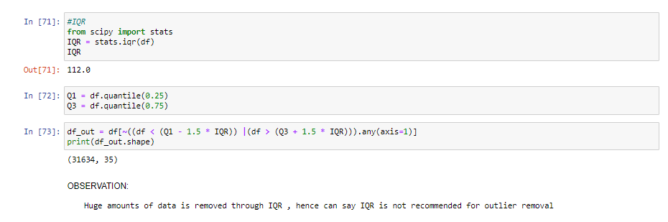
2)IQR:

Slide 30
Mostly outliers are removed by either z score or IQR(Inter Quartile Range).Tried both these approaches first but, the data loss is high in both these approaches. It has been mentioned in guidelines that the data loss should not exceed 7%.So applied capping technique which is also called as winsorization.
Another technique is replacing the outlier data with mean or median. But when we observe this data set there is a huge difference between minimum and maximum values. If we calculate mean or median it wont give appropriate values as it includes the outlier value(maximum ones).So not using this approach.
As we are not dropping the outliers, another approach is capping or winsorization of outliers.
using percentile capping. Values that are less than the value at 10th percentile are replaced by 10th percentile value , and values greater than 90th percentile are replaced by 90th percentile value.

Slide 31
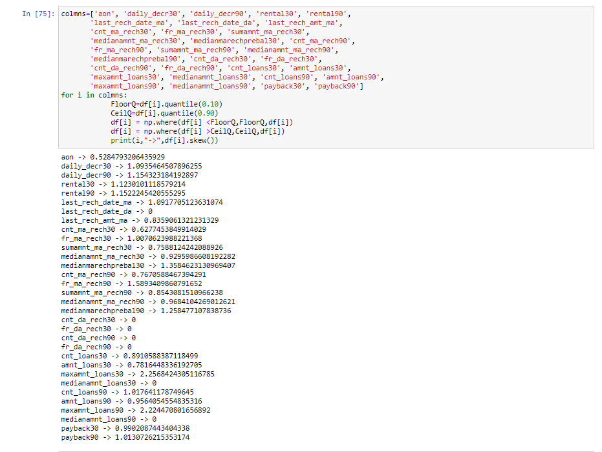

Slide 32
Steps before building model
Data should be segregated into x and y
scaling of x values should be done.
skewness removal needs to be done before splitting into train and test sets.

Slide 33
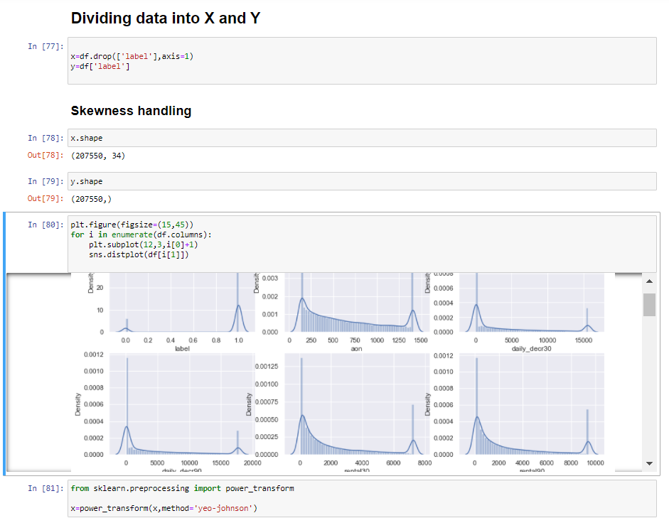

Slide 34
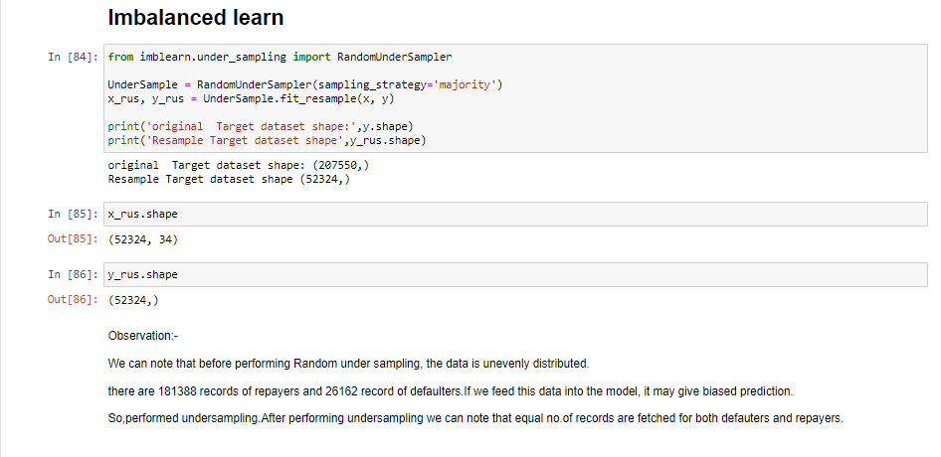
The data set is imbalanced since it has large no. of records which contains data about those repaid the loan and less no. of records of those who defaulted loan.
This might result in biased predictions. So, used imbalance learn library to reduce the imbalances. The imbalance learn library provides different approaches one is Random under sampling. In context of this problem, RandomUnderSampling reduces the no. of records of those who paid the loan. To be precise, RandomUnderSampling deletes data from the majority class such that there will be equal no. of samples of both the classes. Hence reduces the bias.

Slide 35
Algorithms used
I have tried different classification algorithms to check which algorithm performs best.
I did cross validation before fitting a model to avoid over fitting and cross validation also determines a models ability to predict on new data.
List of algorithms used:
Logistic Regression
Decision Tree Classifier
KNeighborsClassifier
RandomForestClassifier
AdaboostClassifier
BaggingClassifier
GradientBoostingClassifier

Slide 36
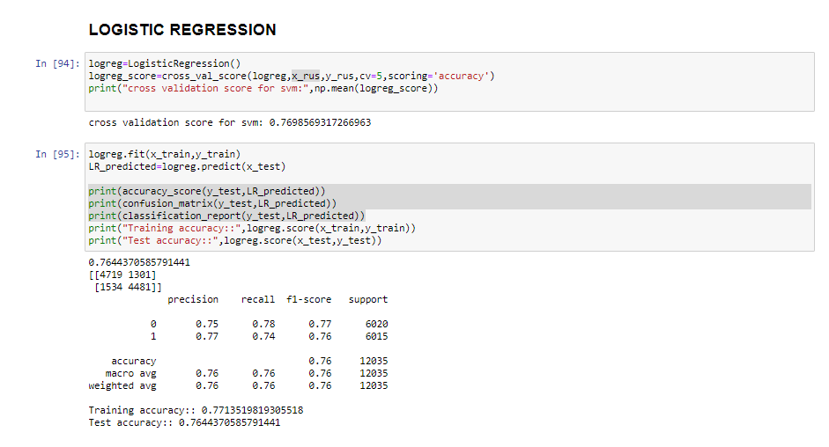

Slide 37
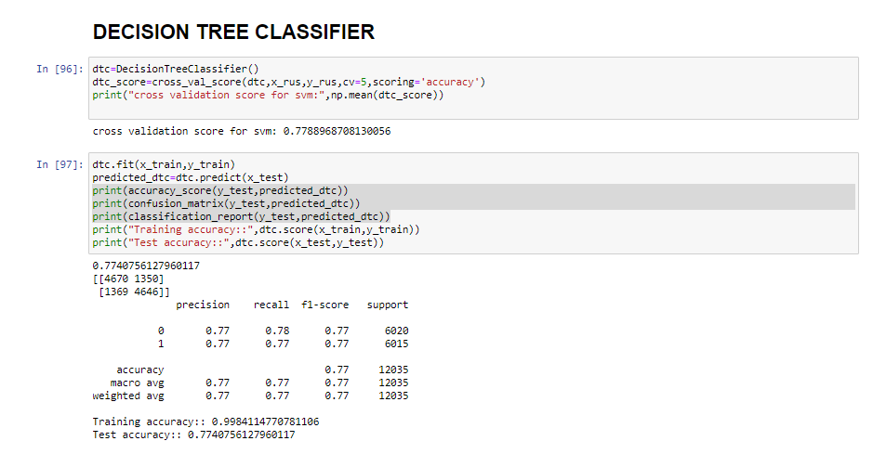

Slide 38
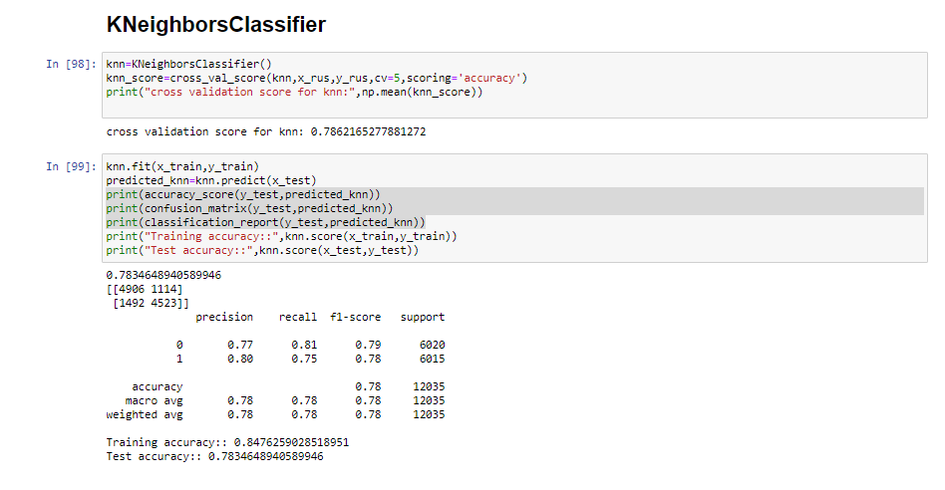

Slide 39
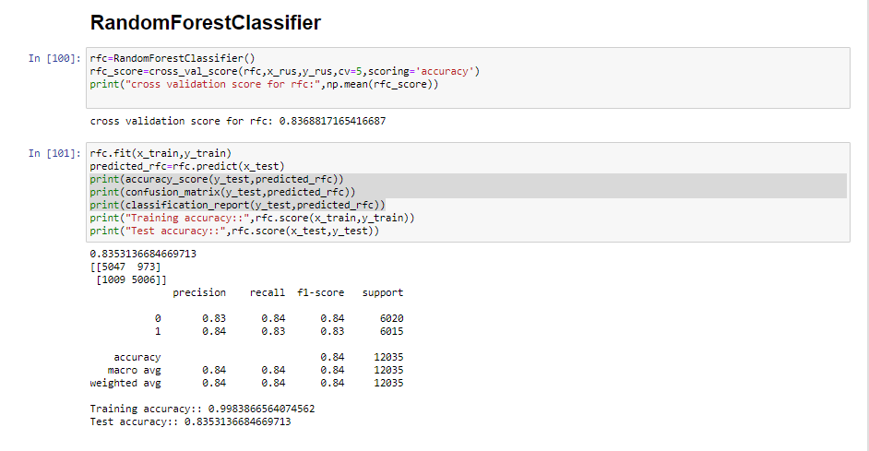

Slide 40
Ensemble models in machine learning operate on a similar idea. They combine the decisions from multiple models to improve the overall performance.
The idea behind bagging is combining the results of multiple models to get a generalized result.
Here I have used the following ensemble techniques.

Slide 41
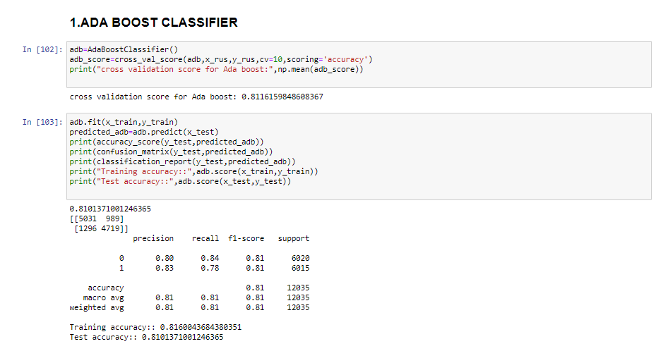

Slide 42
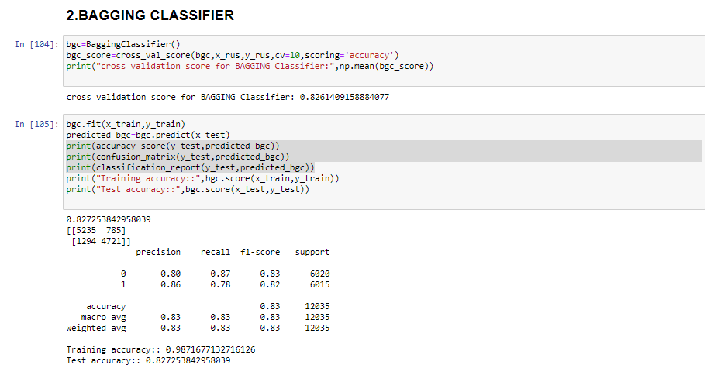

Slide 43
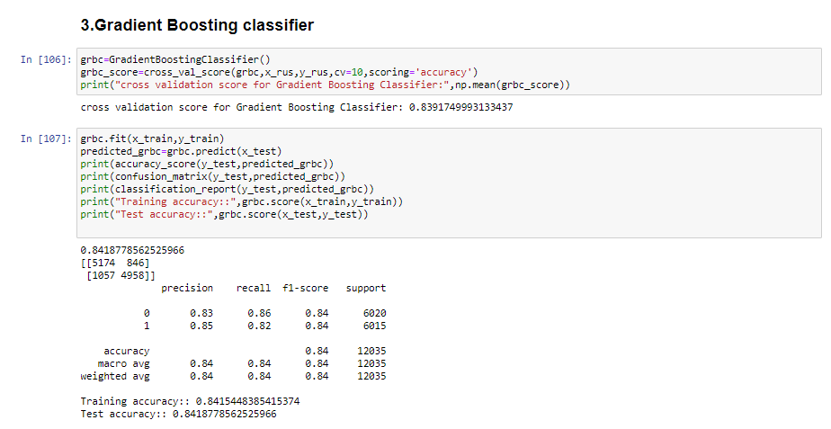

Slide 44
Choosing the Algorithm for Hyper Parameter Tuning
The algorithms are evaluated on different criteria like accuracy, precision, recall
I have chosen
1.Adaboost classifier and
2. GradientBoostingClassifier because there is less difference between train and test accuracies which indicates there will be no over or under fittings.

Slide 45
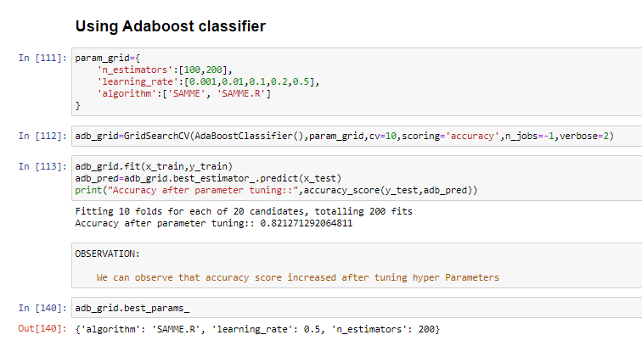
Hyper Parameter Tuning
Hyper parameter tuning is used to increase the performance of the algorithm
Hyper parameter tuning tends to reduce over fitting as well.

Slide 46
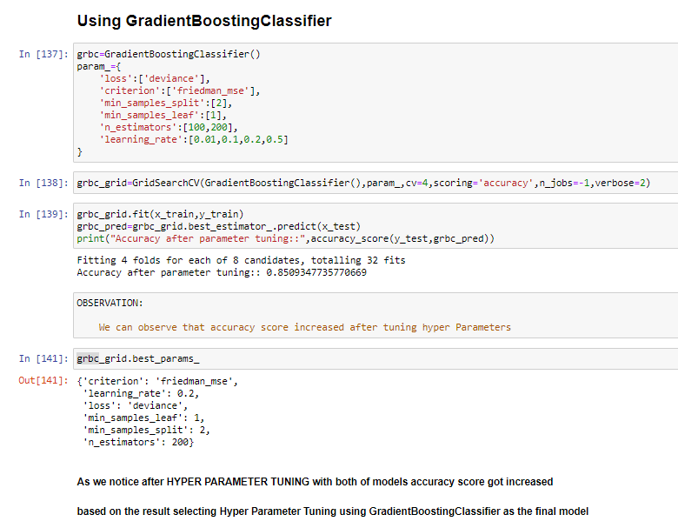

Slide 47
Best model for prediction
After Hyper Parameter Tuning we can see GradientBoostingClassifier tuned very well and giving the best score.

Slide 48
CONCLUSION
The model we built predicts whether the customer defaults or not with an accuracy of 85.09%.
The defaulting rate is higher in old customers. Defaulters recharge for the main account less no. of times but does recharge for data account more no. of times.
Re payers recharge the main account more no. of times when compared to defaulters.
This data set contains data of the year 2016 belonging to PSW telecom circle.
If we get data of other years along with other telecom companies there will be scope for future work on this project.

